Slide 1

LAYER 2
TECHNOLOGIES
prepared by: Khoi Nguyen
presented date: Dec 23, 2008

Slide 2

Objective
Learn about Ethernet, FDDI, and Token Ring, along with the IEEE specifications for each of these technologies.
Learn about the LAN standards that specify cabling and signaling at the physical and data link layers of the OSI reference model.
Be introduced to Layer 2 devices and basic Ethernet 10BASE-T troubleshooting. .

Slide 3
THE DETAIL OF
ETHERNET AND IEEE 802.3

Slide 4
Ethernet introduction
Ethernet is the most widely used local area network (LAN) technology.
Ethernet was designed to carry data at high speeds for very limited distances.
Ethernet is well suited to applications where a local communication medium must carry sporadic, occasionally heavy traffic at high peak data rates.

Slide 5
Ethernet history
1960s, the University of Hawaii.
1970s, Xerox developed the first system.
1980, IEEE released 802.3 specification.
1980s, Digital, Intel and Xerox jointly developed and released an Ethernet specification (v2.0), Compatible with 802.3
Today, the term Ethernet is often used to refer to Ethernet specifications, including IEEE 802.3.

Slide 6
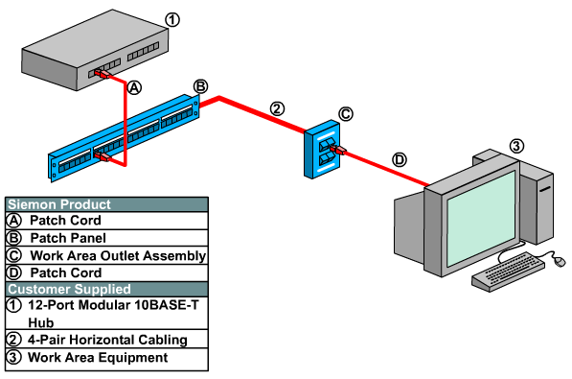
Ethernet family: 10Base-T

Slide 7
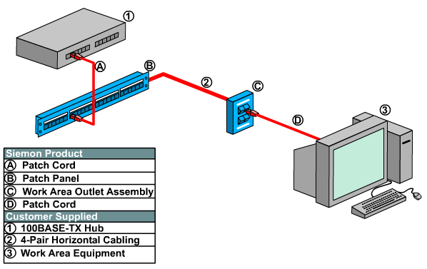
Ethernet family: 100Base-TX

Slide 8
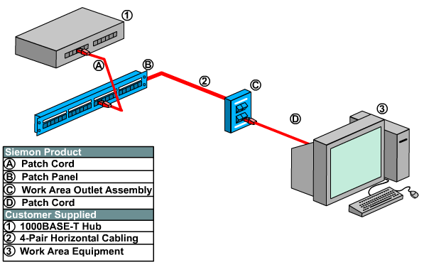
Ethernet family: 1000Base-T

Slide 9
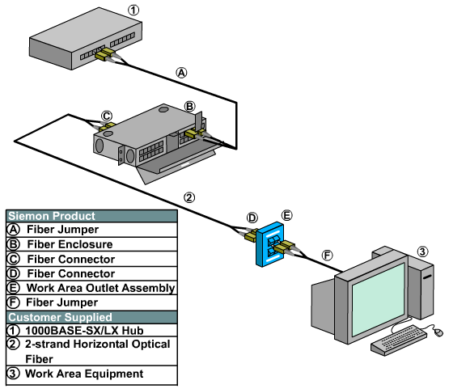
Ethernet family: 1000Base-SX-LX

Slide 10
Media Access Control (MAC)
Shared-media broadcast technology.
Ethernet’s MAC performs three functions:
  transmitting and receiving data packets
  decoding data packets and checking them for valid addresses before passing them to the upper layers of the OSI model
  detecting errors within data packets or on the network

Slide 11
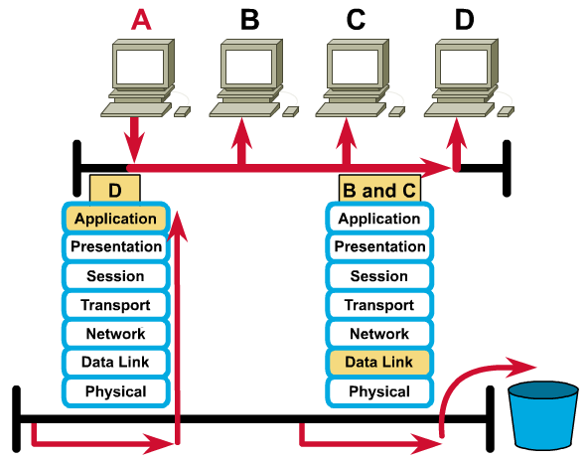
Broadcast technology
MAC

Slide 12
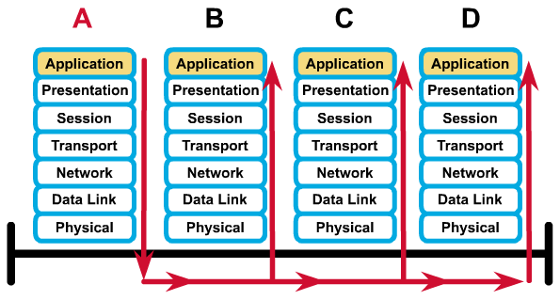
Broadcast address
FF-FF-FF-FF-FF-FF

Slide 13
CSMA/CD
When a station wishes to transmit, it checks the network to determine whether another station is transmitting.
If network is free, the station proceeds with the transmission.
While sending, the station monitors the network to ensure that no other station is transmitting.
If a transmitting node recognizes a collision, it transmits a jam signal so that all other nodes recognize collision.
All transmitting nodes then stop sending for a backoff time (randomly 0 .. 2^{n} - 1 of 51.2μs).

Slide 14
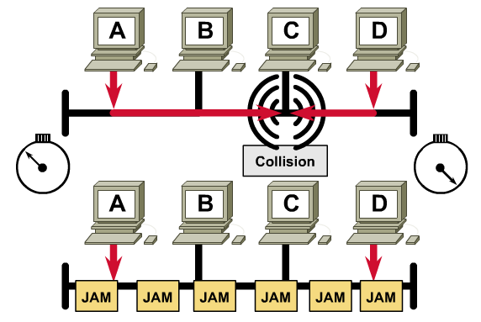
CSMA/CD (cont.)

Slide 15


Hubs Operate at Physical layer
Hubs Operate at Physical layer
Physical
A
B
C
D
  All devices in the same collision domain
  All devices in the same broadcast domain
  Devices share the same bandwidth
Notes:
Emphasize: All devices attached to a hub are on the same collision and broadcast domain. A hub is a layer one device.

Slide 16



Hubs: One Collision Domain
More end stations means more collisions
CSMA/CD is used
Notes:
Purpose: This figure compares hubs in a CSMA/CD environment to a highway with multiple access points.
Emphasize: The more entrance points onto the highway, the greater the likelihood for a collision to occur. Likewise, the more end stations on a hub trying to access the line, the more collisions occur.

Slide 17


Switches and Bridges Operate at Data Link Layer
Data Link
OR
1
2
3
4
1
2
  Each segment has its own collision domain
  All segments are in the same broadcast domain
Notes:
Emphasize: To reduce the number of collisions, a switch can be split into multiple segments, each in a separate collision domain. Note that all segments are in the same broadcast domain.

Slide 18
Switches
Switch
Memory
Each segment has its own collision domain
Broadcasts are forwarded to all segments
Notes:
Purpose: This figure compares the switch to a highway.

Slide 19


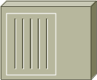

Network Device Domains
Hub
Bridge
Switch
Router
Collision Domains:
1 4 4 4
Broadcast Domains:
1 1 1 4
Notes:
Emphasize: This figure summarizes the different collision domains and broadcast domains on various network devices. It is important that students understand the difference between the two domains.

Slide 20
LAYER 2 DEVICES

Slide 21
Layer 2 Devices
NIC (Network Interface Card)
  Connect your computer with network.
  Provide MAC addresses to each connection.
  Implement CSMA/CD algorithm.
Bridge
  Forward or filter frame by MAC address.
Switch
  Multi-port bridge.

Slide 22
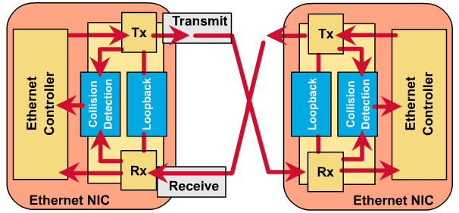
NIC

Slide 23
LAN Switch
Switches connect LAN segments.
LAN switches are considered multi-port bridges with no collision domain.
Use a MAC table to determine the segment on which a frame needs to be transmitted.
Switches often replace shared hubs and work with existing cable infrastructures.
Higher speeds than bridges.
Support new functionality, such as VLAN.

Slide 24
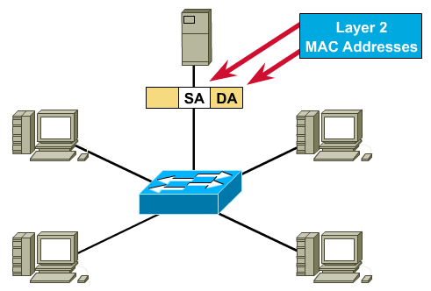
LAN Switch (cont.)

Slide 25
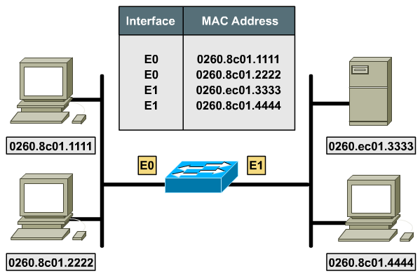
LAN Switch: MAC table

Slide 26
Benefits of LAN Switch
No collision domain, because of micro-segmentation.
Low latency levels and a high rate of speed for frame forwarding
Increases the bandwidth available on a network
Is performed in hardware instead of in software, it is significantly faster.
BUT: All hosts connected to the switch are still in the same broadcast domain.

Slide 27
BASIC OF
TROUBLESHOOTING SKILL

Slide 28
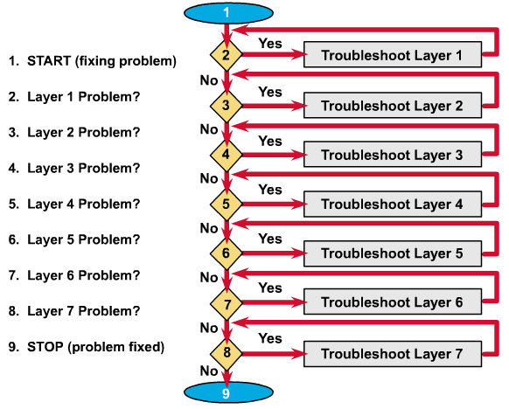
Basic 10BaseT troubleshooting

Slide 29
Thank you
Thanks for your attention!

